Slide 1
Levels of Abstraction
Physical level: describes how a record (e.g., instructor) is stored.
Logical level: describes data stored in database, and the relationships among the data.
type instructor = record
ID : string; name : string; dept_name : string; salary : integer;
end;
View level: application programs hide details of data types. Views can also hide information (such as an employee’s salary) for security purposes.
Notes:
1

Slide 2
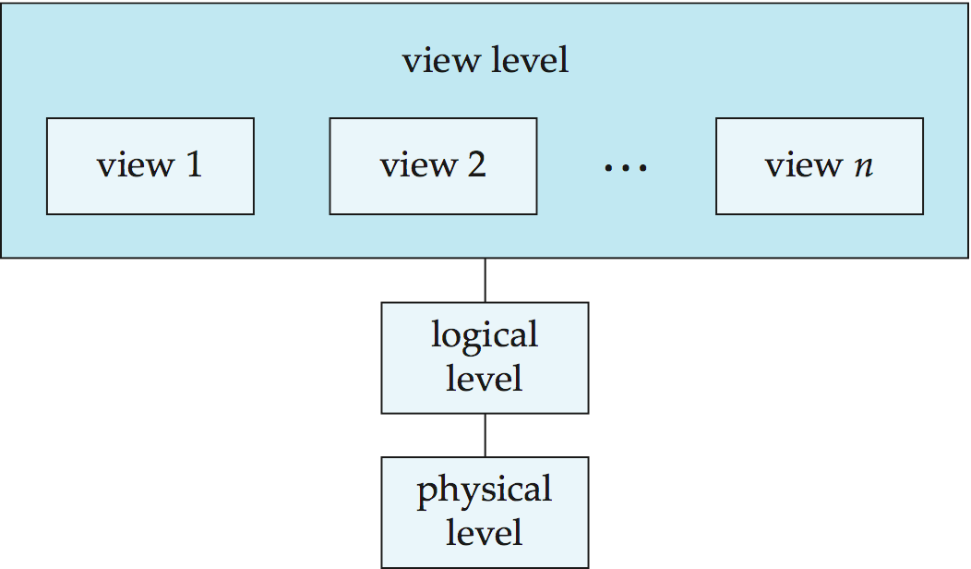
View of Data
An architecture for a database system
Notes:
2

Slide 3
Database Design
The process of designing the general structure of the database:
Logical Design – Deciding on the database schema. Database design requires that we find a “good” collection of relation schemas.
Business decision – What attributes should we record in the database?
Computer Science decision – What relation schemas should we have and how should the attributes be distributed among the various relation schemas?
Physical Design – Deciding on the physical layout of the database
Notes:
3

Slide 4
Design Approaches
Need to come up with a methodology to ensure that each of the relations in the database is “good”
Two ways of doing so:
Entity Relationship Model (Chapter 7)
Models an enterprise as a collection of entities and relationships
Represented diagrammatically by an entity-relationship diagram:
Normalization Theory (Chapter 8)
Formalize what designs are bad, and test for them
Notes:
4

Slide 5
Database Architecture
The architecture of a database systems is greatly influenced by
the underlying computer system on which the database is running:
Centralized:
Entire database system is located on a single computer system.
All data storage, processing, and access tasks are managed centrally.
Simple architecture but can be a single point of failure and limits scalability.
Client-server:
Database system divided into client and server components.
Server hosts the database, manages data storage and processing.
Clients connect to the server to request and retrieve data.
Offers distributed processing, scalability, and better resource management.
Notes:
5

Slide 6
3. Parallel (multi-processor):
Database system utilizes multiple processors working in parallel.
Data is divided and processed simultaneously by multiple processors.
Enables high-performance computing, faster data processing, and scalability.
4. Distributed:
Database system is spread across multiple computers or servers.
Data is stored and processed on different nodes.
Requires coordination to ensure data consistency and integrity.
Provides scalability, fault tolerance, and handling of geographically dispersed data.

Slide 7
Basic Definitions
Database:
A collection of related data.
Data:
Known facts that can be recorded and have an implicit meaning.
Mini-world:
Some part of the real world about which data is stored in a database. For example, student grades and transcripts at a university.
Database Management System (DBMS):
A software package/ system to facilitate the creation and maintenance of a computerized database.
Notes:
7

Slide 8
Basic Definitions
Database Administrator(DBA):
Is a person or group of person who is responsible for the management of the database
Database System:
The DBMS software together with the data itself. Sometimes, the applications are also included.
Slide 1- 8
Notes:
8

Slide 9
Basic Definitions
Entity:
A item,person,event about which information is stored is called entity.
Example: STUDENT
Attributes:
Is a property or characteristics of an entity that is of interest to the organization.
Exampled: Name,Class,Roll no.
Relationship:
The association among Entities
One to one ,Many to Many,One to Many Relationship
Slide 1- 9
Notes:
9

Slide 10
Basic Definitions
Data Dictionary:
Keep track of metadata i.e data about data such as relation name,attributes name and types,constraints and user information.
It is also called System Catalog or Repository.
Active data dictionary is accessed by DBMS software and users/DBA.
Passive data dictionary is accessed by users/DBA only.
Slide 1- 10
Notes:
10

